Slide 1


Recommendation Systems News and Ads Recommendation
Pathuru Sai Siva Naga Chandra
Dhulipudi Venkata Satya Sai Rakesh
Mentor:
Athul

Slide 2
Introduction
In today's digital landscape, the delivery of news articles has evolved alongside the rise of sophisticated ad recommendation systems. These systems have revolutionized the way advertisements are tailored and presented to users based on their preferences and interests.
With the advent of personalized ads, news articles can now be accompanied by targeted advertising that resonates with individual users. By analyzing user behavior and collecting data on their online activities, ad recommendation systems can effectively curate advertisements that align with their specific interests.

Slide 3
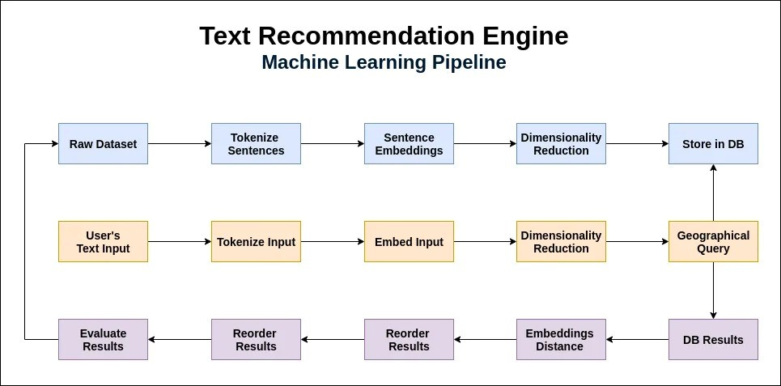
The Standard Structure of Text Recommendation Engine

Slide 4
BERT
Bidirectional Encoder Representations from Transformers (BERT) is a revolutionary natural language processing model that has gained significant attention in recent years. BERT, a transformer-based neural network architecture, has proven to be highly effective in various language tasks such as question answering, sentiment analysis, and text classification.
BERT has been trained on massive amounts of data from various sources, enabling it to learn intricate patterns and semantic relationships. As a result, it can generate highly accurate representations of words and sentences. These representations can then be used as powerful features for downstream NLP tasks.

Slide 5
BERT
The key concept behind BERT is its ability to capture the contextual relationships between words by considering both the left and right context of each word. This bidirectional approach allows BERT to have a deep understanding of the nuances and intricacies of language.
In conclusion, Bidirectional Encoder Representations from Transformers (BERT) represents a significant breakthrough in natural language processing. Its ability to capture contextual relationships has revolutionized various language tasks and opened up new possibilities for advanced NLP applications.

Slide 6
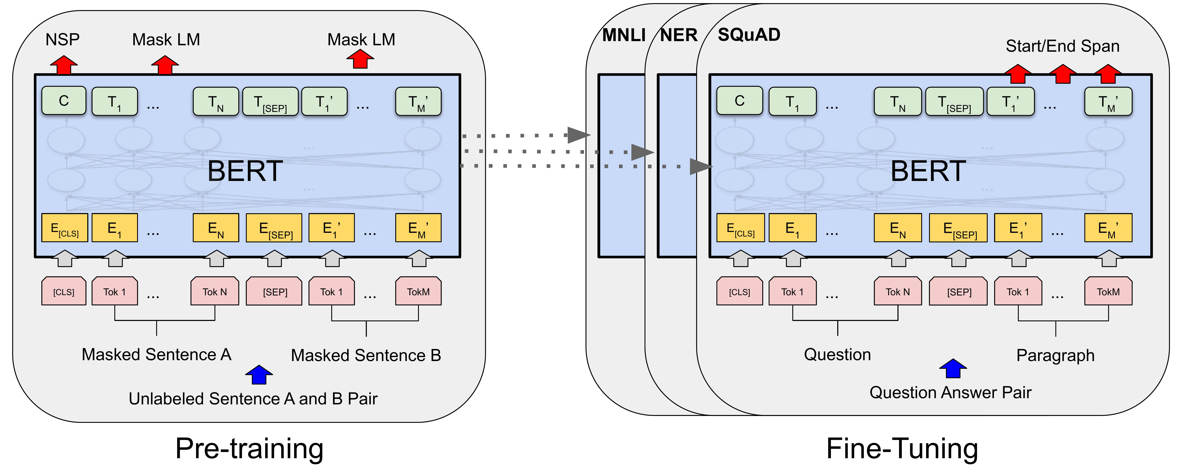
How BERT Works?

Slide 7
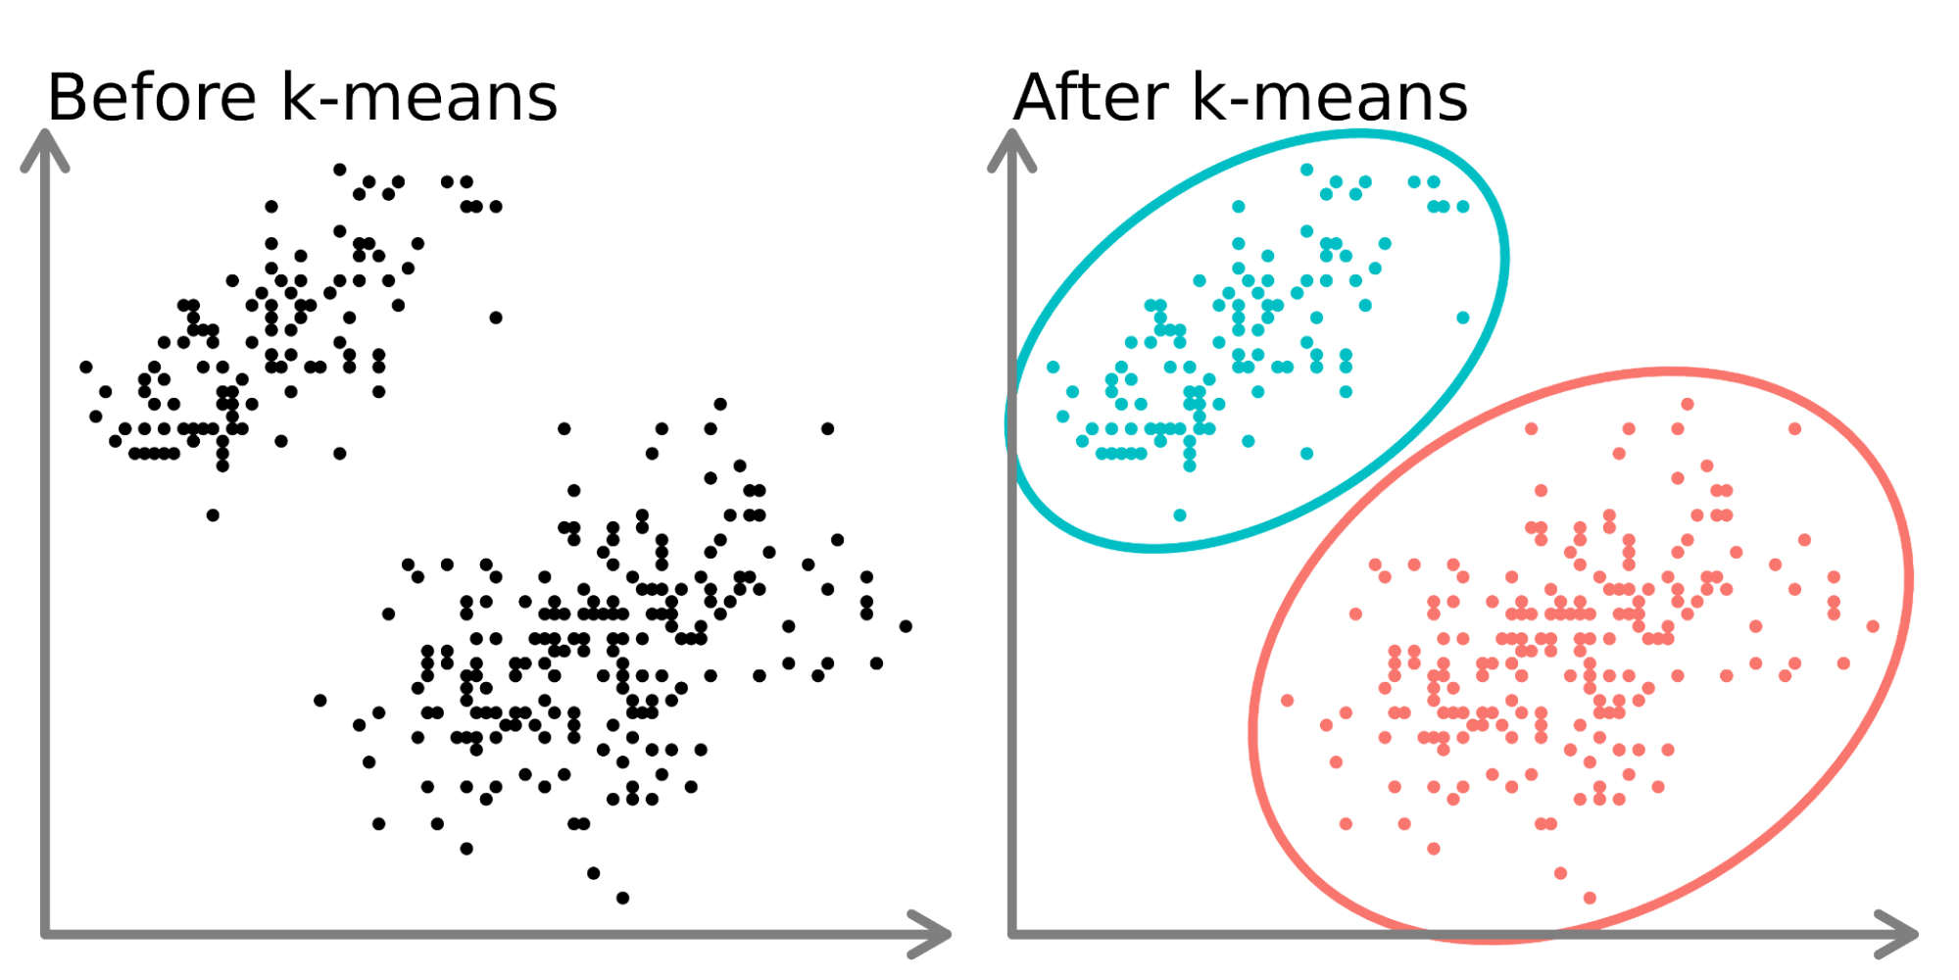
K-Means
K-means clustering aims to partition data into k clusters in a way that data points in the same cluster are similar and data points in the different clusters are farther apart.
Relatively simple to implement.
Scales to large data sets.
Guarantees convergence.
Easily adapts to new examples.

Slide 8
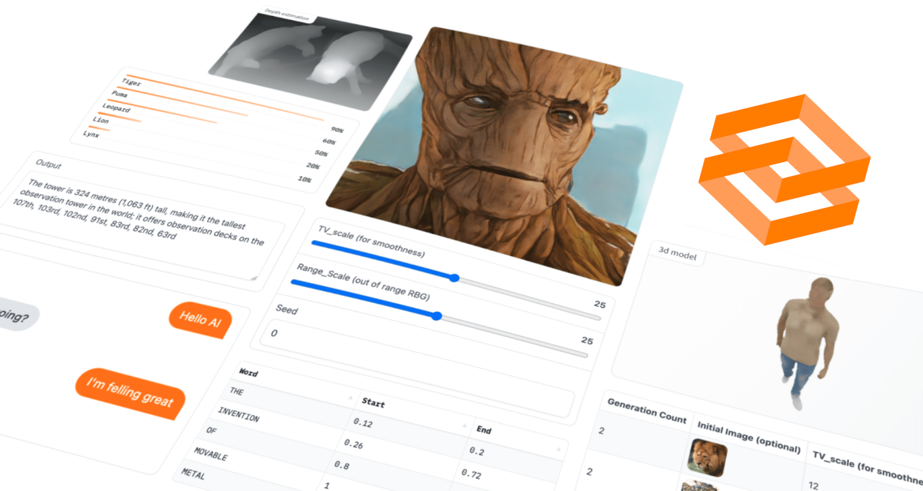
Gradio
Gradio is the fastest way to demo your machine learning model with a friendly web interface so that anyone can use it, anywhere!

Slide 9
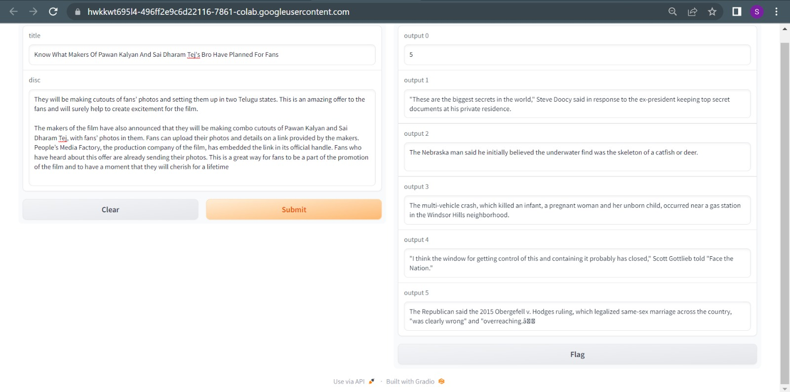
Results

Slide 10
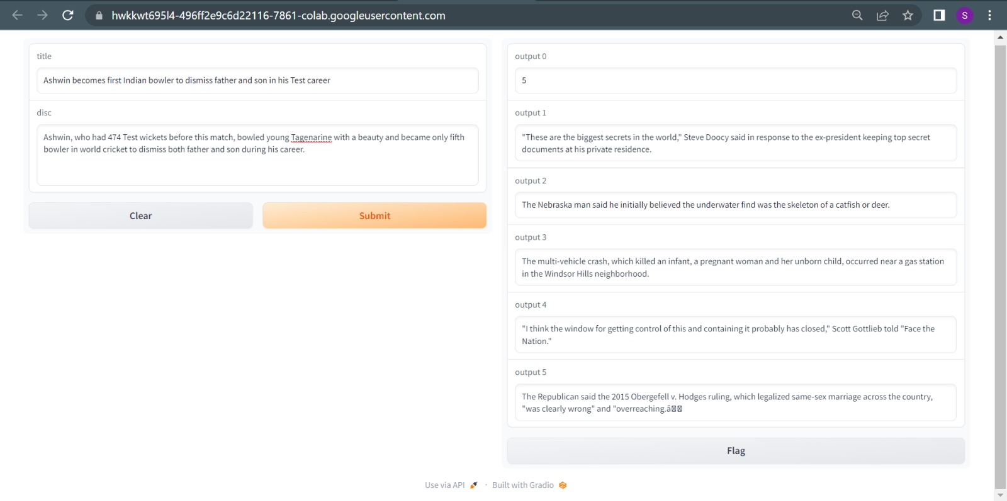
Results

Slide 11
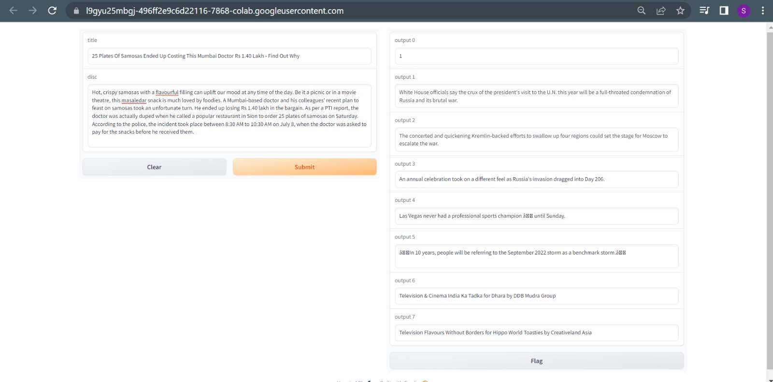
Results

Slide 12
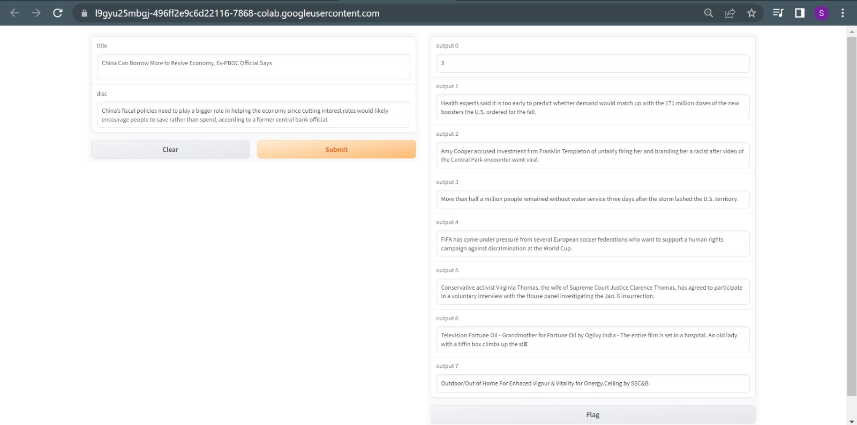
Results

Slide 13
Discussion
In the realm of news and advertising, the utilization of advanced technologies such as Python, BERT, and K-Means clustering has paved the way for more effective recommendation systems. These systems not only enhance user experience but also optimize content delivery and targeted advertising.
The integration of BERT, a state-of-the-art natural language processing model, with K-Means clustering enables the creation of powerful article recommendation systems. By leveraging BERT's ability to understand contextual meaning and semantic relationships within text, relevant news articles can be identified and recommended to users based on their preferences and interests.
Overall, the integration of Python programming language alongside BERT and K-Means clustering offers a powerful solution for developing efficient news and ad recommendation systems that cater to individual user needs while optimizing content delivery and advertising effectiveness.

Slide 14
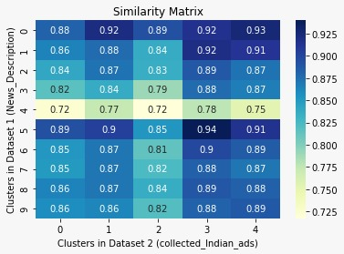
Discussion
Similarity matrix is the opposite concept to the distance matrix . The elements of a similarity matrix measure pairwise similarities of objects – the greater similarity of two objects, the greater the value of the measure
It gives similarity between the dataset-1 i.e. News Data Set and the dataset-2 i.e. Ads Data Set so as to give the user of how relevant both the datasets are

Slide 15
Conclusion
The combination of Python programming language with BERT and K-Means clustering provides a robust foundation for developing intelligent news and ad recommendation systems. These systems not only enhance user engagement but also optimize content delivery by delivering targeted information that aligns with users' interests.
The implementation of this technology offers several benefits. Firstly, it enhances user experience by delivering personalized recommendations tailored to individual interests. Secondly, it improves engagement and click-through rates by presenting users with content that aligns with their preferences. Lastly, it optimizes ad placements by ensuring that advertisements are targeted towards users who are most likely to be interested in them.
To Conclude, the integration of Python, BERT, and K-Means clustering in news and ad recommendation systems opens up new possibilities for delivering highly targeted content to users while maximizing engagement and conversion rates.

Slide 16
THANK YOU
Any Queries..?

